Slide 1
The Human Factor in Acquisitions: Cross-industry Labor Mobility and Corporate Diversification
Geoffrey Tate
University of Maryland and NBER, USA
Liu Yang
University of Maryland, USA
The Review of Financial Studies
May 26, 2023
Presented by: Yan Li

Slide 2
Research Question:
How important is human capital for determining the boundaries of the firm? How the transferability of human capital affects the decision to diversify into new industries by acquisition.

Slide 3
Prior Literature
The motives for corporate diversification: Stein 1997; Maksimovic and Phillips 2002; Villalonga 2004; Ozbas and Scharfstein 2010
The growing literature linking labor economics to corporate finance: Agrawal and Matsa 2013; Simintzi, Vig, and Volpin 2015; Graham et al. 2016
The large literature on the determinants of merger decisions: Ahern and Harford 2014; Hoberg and Phillips 2012
The growing set of literature exploiting worker firm matched data to study labor market mobility: Bjelland et al. 2011; Papageorgiou 2014; Neffke, Otto, and Weyh 2017

Slide 4
Theoretical Motivation
Prediction 1. Diversifying mergers occur with a greater frequency between firms in industries between which there is higher transferability of human capital.
Prediction 2. The effect of human capital transferability on the frequency of diversifying deals is strongest among industries in which productivity shocks are less positively correlated.
Prediction 3. Among diversifying mergers, those in which the merging firms come from industries between which there is higher transferability of human capital achieve greater post-merger changes in productivity.
Prediction 4. Among diversifying mergers, those that combine firms from high human capital transferability industry pairs are followed by more internal worker transfers and higher retention rates of high-skill workers.

Slide 5
Data
The U.S. Census Bureau’s Longitudinal Business Database (LBD): changes in ownership.
Longitudinal Employer-Household Dynamics (LEHD) program: worker-level information
Diversifying Acquisition: if there is no overlap in the Fama-French 49 industry codes of the acquiring and target firms’ establishments prior to the deal. It excludes cases in which acquirers seek to expand their operations in the overlapping industries rather than to take advantage of human capital synergies across industries
Final Sample: 4,000 diversifying acquisitions from 1995 to 2007

Slide 6
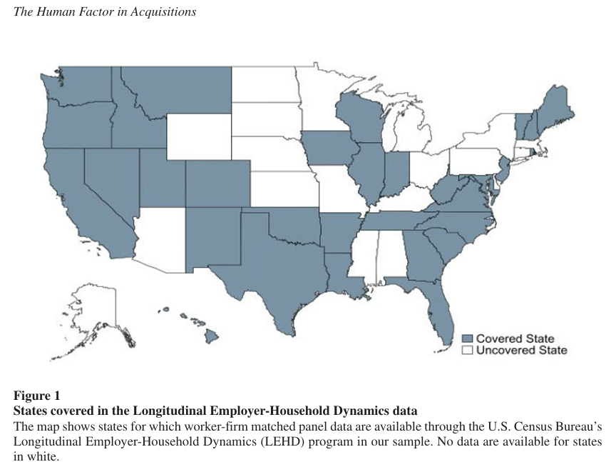
Longitudinal Employer-Household Dynamics (LEHD)
Quarterly employer-employee matched observations for 31 states in the country
Two purposes of using this data:
- to construct a measure of human capital transferability (HCT) across industries.
- to measure the consequences of mergers at the worker level.

Slide 7
Human capital transferability (HCT) across industries
The broader transferability of workers’ skills across industries: proxied by worker job-to-job flows
The HCT index: an economywide index of worker mobility between Fama-French industry groups.
11.5 million external job changes
exclude workers with less than 1 year of tenure in their prejob change firms to limit the effect of temporary workers on the analysis
exclude workers in counties with fewer than 10 industries so that it’s more likely to capture industry changes that reflect workers’ preferences, not location constraints
- exclude large synchronized moves in which more than 10 workers from the same existing firm move to the same new firm during the same quarter because such worker flows might be themselves driven by ownership changes in the existing firm
A nondirectional measure of human capital transferability = the average of the fraction of workers from each industry that move to the other industry in the pair.

Slide 8
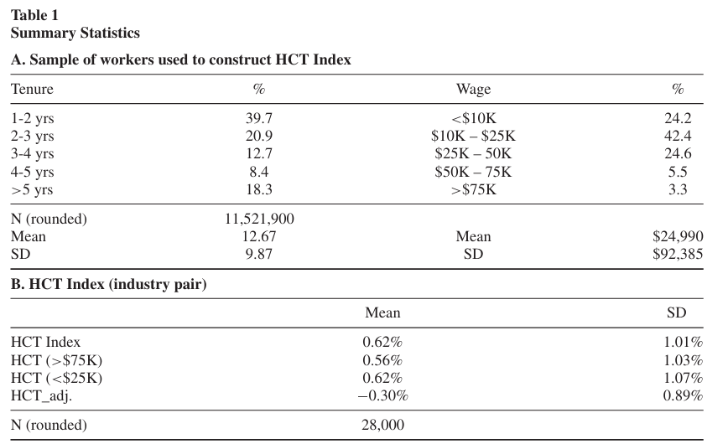
Summary statistics
HCT_adj: the industry-size-adjusted version of index

Slide 9
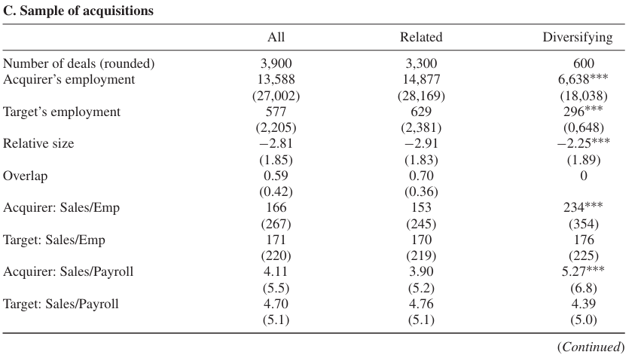
Summary statistics

Slide 10
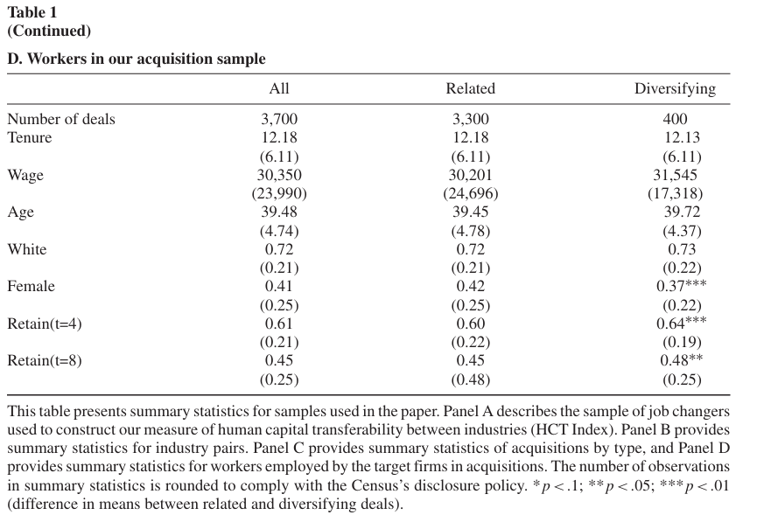
Summary statistics

Slide 11
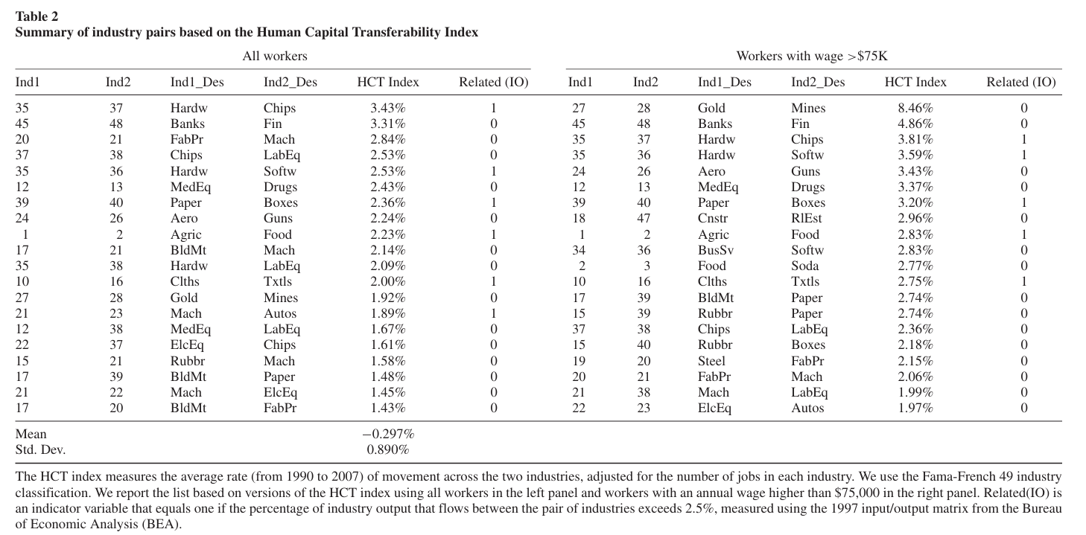
Summary statistics
Table2 list pairs of industries between which we see a high frequency of worker movement using the industry-size-adjusted HCT index.
Product market connections

Slide 12
Prediction 1: HCT and industry choices in diversifying deals
Y measures the intensity with which acquirers in industry i diversify into industry j (for i=j) in sample year t
HCT is the human capital transferability index between industries i and j measured over a 5-year window ending at t −1
X is a vector of controls in year t. Including control for product market linkages across industries
They include all of the 48 by 47 cross-industry pairs in the period between 1995 and 2007 for which the researchers can define the HCT index

Slide 13
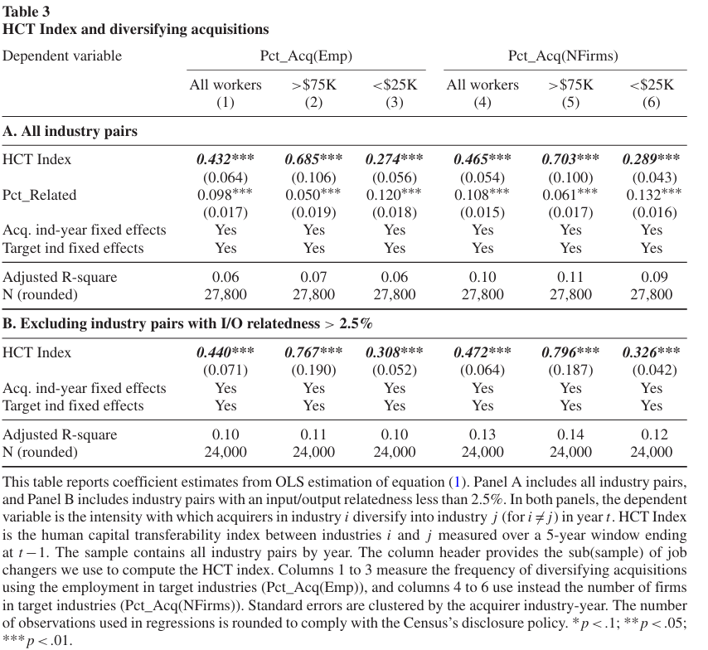
Prediction 1: HCT and industry choices in diversifying deals
1-3 Use the employment-based dependent variable to measure acquisition frequency
4-6 use the number of firms involved in transactions
High human capital transferability between a target industry and an acquirer’s existing industries predicts significantly more diversification into that industry.

Slide 14
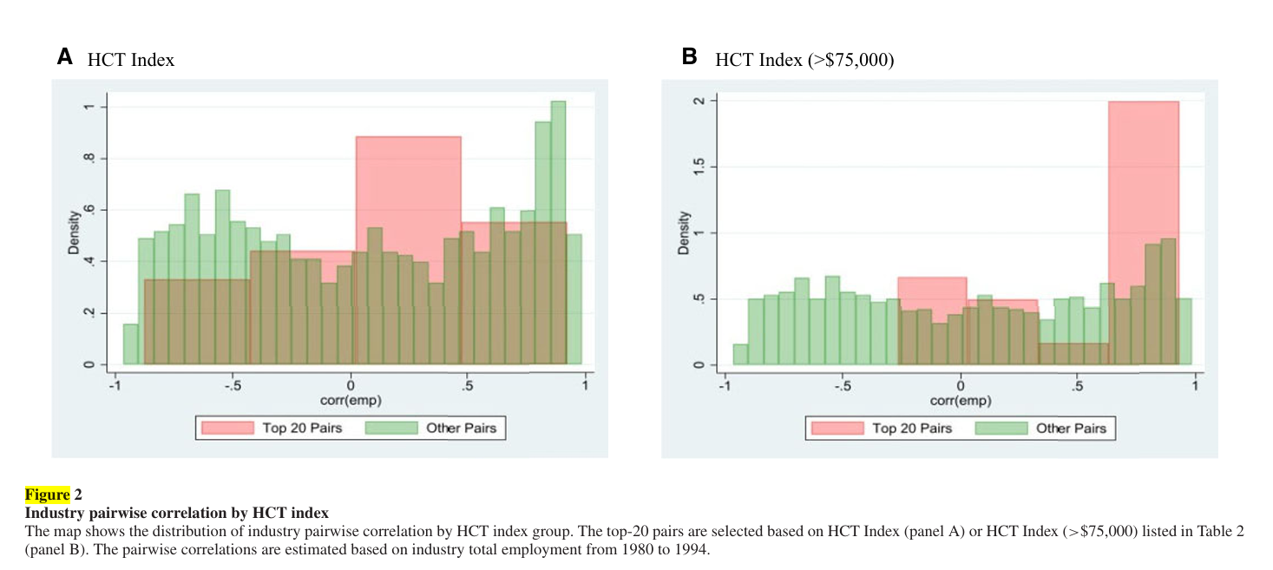
Prediction 2: Correlation in growth opportunities
The correlation of employment between each pair of industries. Correlations are higher among the top-20 high-HCT pairs

Slide 15
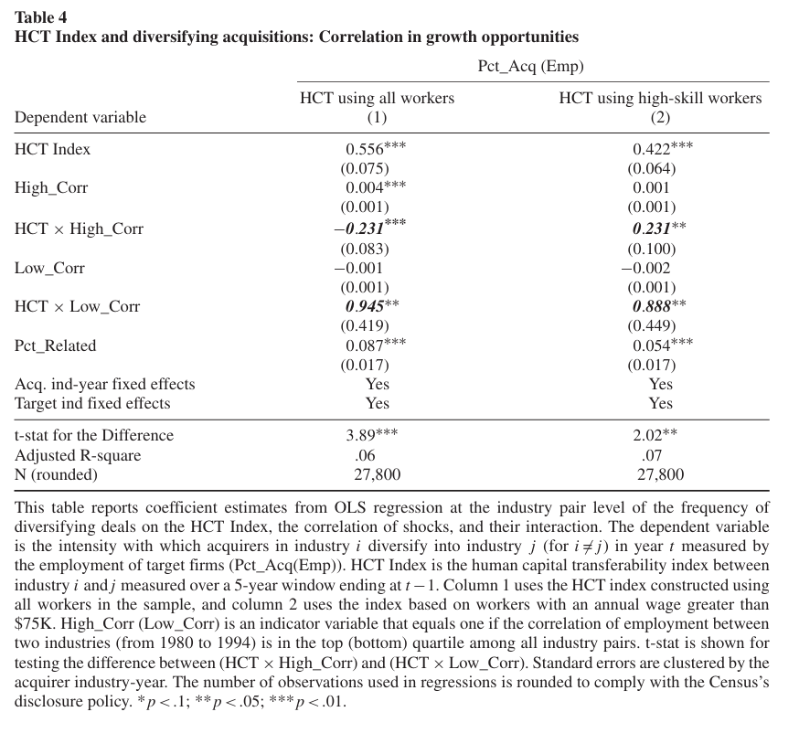
Prediction 2: Correlation in growth opportunities
The HCT index has a significantly stronger association with the frequency of diversifying deals among industry pairs with the least correlated employment shocks.
If the industries that define the divisions experience less correlated shocks, it is more likely that workers from the division with bad opportunities who are transferred to the division with good opportunities do not need to be replaced in their original jobs, preserving maximal adjustment cost savings for the firm.

Slide 16

Prediction3: HCT and post deal changes in labor productivity
acquiring and target firms can operate in multiple industries, we compute a deal-level HCT index for each diversifying deal as a double weighted average of the HCT index between each pair of industries operated by the acquiring and target firms
Y: labor productivity change
Divers: an indicator variable that takes the value of one for diversifying deals;
High_HCT: an indicator variable equal to one if the value of the HCT index is in the top quartile in our sample; Three groups: within-industry deals (Divers=0 and Divers×High_HCT=0),
low HCT diversifying deals (Divers=1 and Divers×High_HCT=0),
and high HCT diversifying deals (Divers=1 and Divers×High_HCT=1).

Slide 17
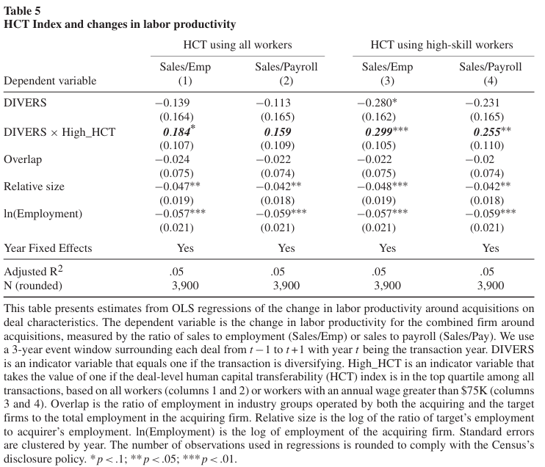
Prediction3: HCT and post deal changes in labor productivity
Relative size and ln(Employment):
Significant negative; higher costs of integrating new workers in larger deals
High-HCT deals have an 18.4-percentage-point larger increase in labor productivity than other diversifying deals

Slide 18
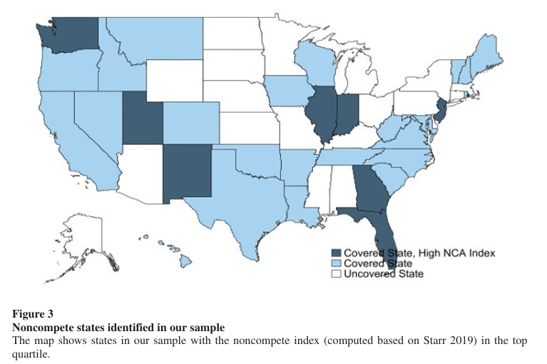
Identification: Variation in the enforcement of noncompete agreements
Stronger enforcement of NCAs (noncompete agreements) decreases worker mobility in external labor markets

Slide 19
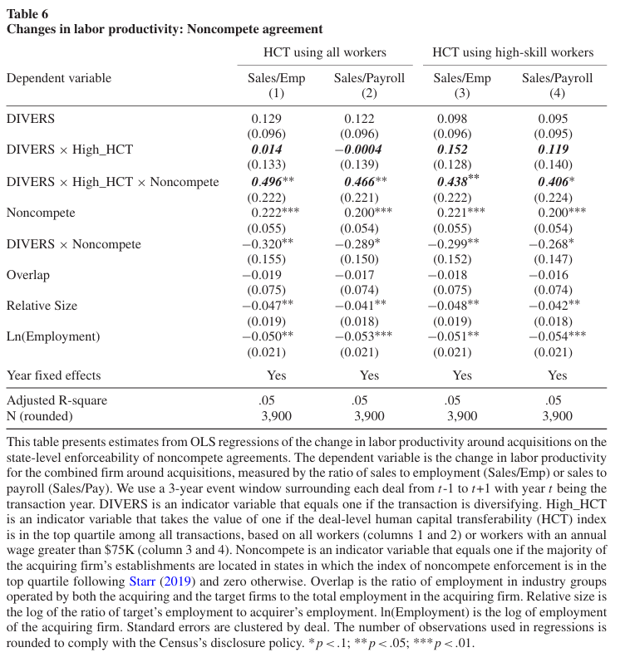
Identification: Variation in the enforcement of noncompete agreements
significantly larger increases in labor productivity in high-HCT deals among acquirers operating in high NCA enforceability regimes

Slide 20
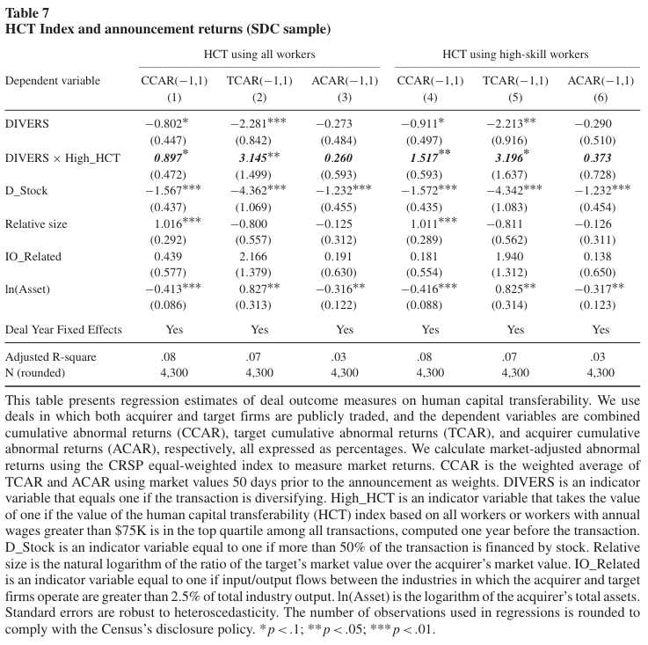
Alternative performance measure: Stock market reactions
The combined CARs at the announcement are higher among high-HCT than among low-HCT deals.

Slide 21
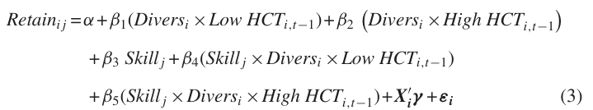
Prediction4: Human Capital Transferability and Worker Outcomes
Divers: an indicator variable equal to one if the acquirer and target do not operate in any common Fama-French industry groups prior to the acquisition.
Low HCT and High HCT: indicator variables that equal one if the value of the HCT index measured one year prior to the deal is below or above the median, respectively.
Three groups : within-industry acquisitions (Divers × LowHCT =0andDivers×HighHCT =0),
diversifying acquisitions with low-HCT (Divers × Low HCT =1 and Divers × High HCT =0),
and diversifying acquisitions with high-HCT (Divers × Low HCT =0 and Divers × High HCT =1).

Slide 22
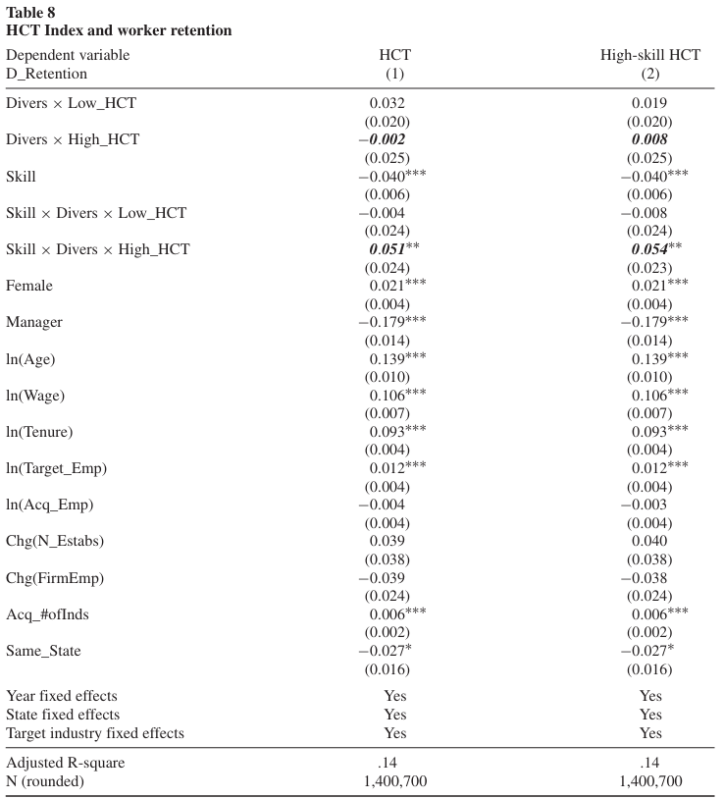
Prediction4: Human Capital Transferability and Worker Outcomes
The marginal effect of high human capital transferability on the likelihood of retaining high-skilled workers is positive and significant
Female workers, higher-wage workers, and workers with more experience (age, tenure) are more likely to remain with the merged firm. Managers are unlikely to be retained.

Slide 23
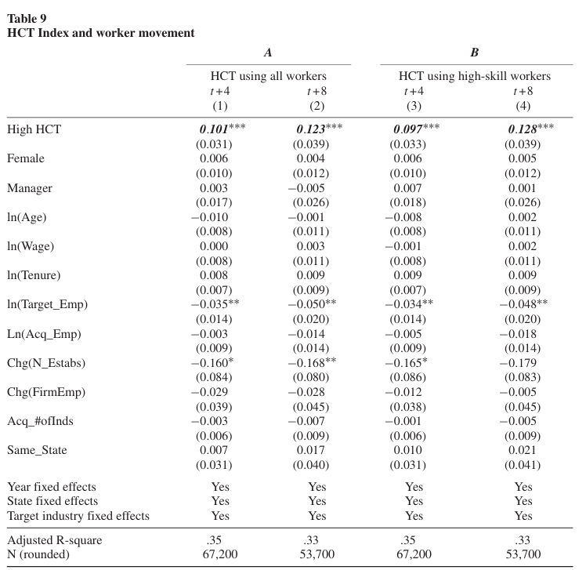
Worker internal movement
This table presents, estimates from linear probability models on the sample of workers from target firms who were retained following diversifying acquisitions.
Move is an indicator variable equal to one if the worker moved to one of the acquirer’s predeal reporting units after the acquisition, thereby changing industries
the workers from the targets in high-HCT deals are more likely to move to the acquirer’s units following the merger

Slide 24
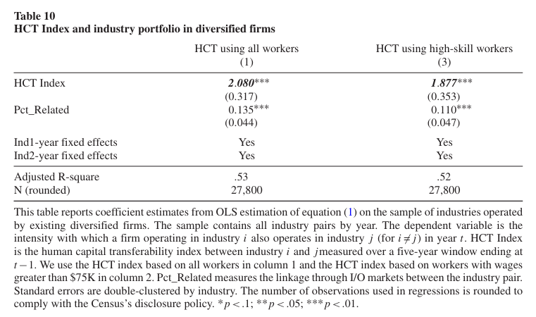
Human Capital Transferability and Firm Composition
Measure the frequency with which each industry pair is jointly operated by existing diversified firms.
a strong and significant positive relation between human capital transferability and the industries that are jointly operated by diversified firms.
Human capital transferability has more explanatory power for the composition of diversified firms than the product market relatedness of the industries

Slide 25
Conclusions
Human capital transferability not only predicts the intensity with which firms diversify into other industries but also predicts the intensity more strongly than measures of product market relatedness. Moreover, it predicts the industry composition of diversified firms in the cross-section.
Firms that acquire industries with greater human capital transferability with their existing industries enjoy larger increases in labor productivity and are less likely to divest their newly acquired industries subsequently.
Acquiring firms that diversify into industries with high human capital transferability with their existing operations are more likely to retain skilled workers following the deal and to transfer workers from the target firm to other industries in the merged firm.

Slide 26
Thank you!

